Slide 1
Distributed File System
CE7490 Group 7

Slide 2
Basic Facts
Based on Google File System
Instead of using Replicas, we employ Hierarchical codes for effective recovery
One Master, Multiple Slaves and Multiple Clients

Slide 3
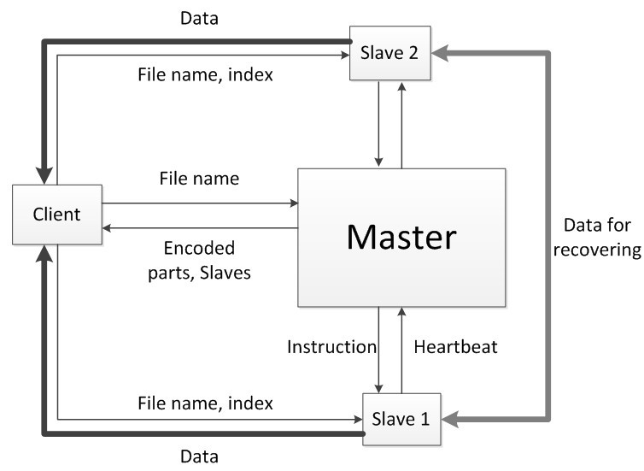
Architecture
Notes:
The master maintains the metadata of files stored in this system and interacts with clients by responding read/ write request. It also manages slaves and handles the machine failures. We will show it soon. Slaves are responsible for storing data and returning data when they are requested. Each slave sends heartbeat message to the master periodically to claim it is still alive.

Slide 4
Write Operation
Slave 1
Slave 2
Slave 3
Client
Master
…
Slave 8
Slave 9
Slave 10

Slide 5
Write Operation
Slave 1
Slave 2
Filename | Size | O1 | O2 | … | O1O2O3O4
hw.pdf | 21k | Slave 1 | Slave 7 | … | Slave 5
… | …. | … | … | … | …
prez.ppt | 120k | Slave 6 | Slave 5 | … | Slave 2
a.jpg | 100k | Slave 1 | Slave 10 | … | Slave 2
Slave 3
Write file “a.jpg”
size 100k
…
Client
Master
Slave 8
Slave 9
Slave 10

Slide 6
Write Operation
Slave 1
Slave 2
Slave 3
<O1, Slave 1>
<O2, Slave 10>
…
<O1O2O3O4, Slave2>
Client
Master
…
Slave 8
Slave 9
Slave 10

Slide 7
Write Operation
Slave 1
Slave 2
Slave 3
Client
Master
…
a.jpg
Slave 8
Slave 9
Slave 10

Slide 8
Write Operation
Slave 1
Slave 2
Slave 3
Client
Master
…
O1O2
O3O4
O1O2O3O4
Slave 8
O1
O2
O3
O4
Slave 9
Slave 10

Slide 9
Read Operation
Slave 1
Slave 2
Slave 3
Client
Master
…
Slave 8
Slave 9
Slave 10

Slide 10
Read Operation
Slave 1
Slave 2
Slave 3
Read file “b.jpg”
Client
Master
…
Slave 8
Slave 9
Slave 10

Slide 11
Read Operation
Slave 1
Slave 2
Filename | Size | O1 | O2 | … | O1O2O3O4
hw.pdf | 21k | Slave 1 | Slave 7 | … | Slave 5
… | …. | … | … | … | …
b.jpg | 200k | Slave 1 | Slave 10 | … | Slave 6
… | … | … | … | … | …
Slave 3
Read file “a.jpg”
Client
Master
…
Slave 8
Slave 9
Slave 10

Slide 12
Write Operation
Slave 1
Slave 2
Slave 3
Size: 200k
<O1, Slave 1>
<O2, Slave 10>
…
<O1O2O3O4, Slave 6>
Client
Master
…
Slave 8
Slave 9
Slave 10

Slide 13
Read Operation
Slave 1
Slave 2
Slave 3
Client
Master
…
Slave 8
Slave 9
Slave 10

Slide 14
Read Operation
Slave 1
Slave 2
O1
Slave 3
O3
Client
Master
…
Slave 8
Slave 9
Slave 10
O4
O2

Slide 15
Read Operation
Slave 1
Slave 2
Slave 3
Client
Master
…
b.jpg
Slave 8
Slave 9
Slave 10

Slide 16
Read Operation
Slave 1
Slave 2
O1
Slave 3
O3
Client
Master
…
Slave 8
Slave 9
O3O4
Slave 10
O4
O4
O2

Slide 17
Read Operation
Slave 1
Slave 2
Slave 3
Client
Master
…
b.jpg
Slave 8
Slave 9
Slave 10

Slide 18
Failure Detection
Slaves send heartbeat messages to the master periodically
The master updates timestamp of a slave once it hears the heartbeat
The master checks timestamps periodically to find timeout slaves
Dead slaves Damaged Files

Slide 19
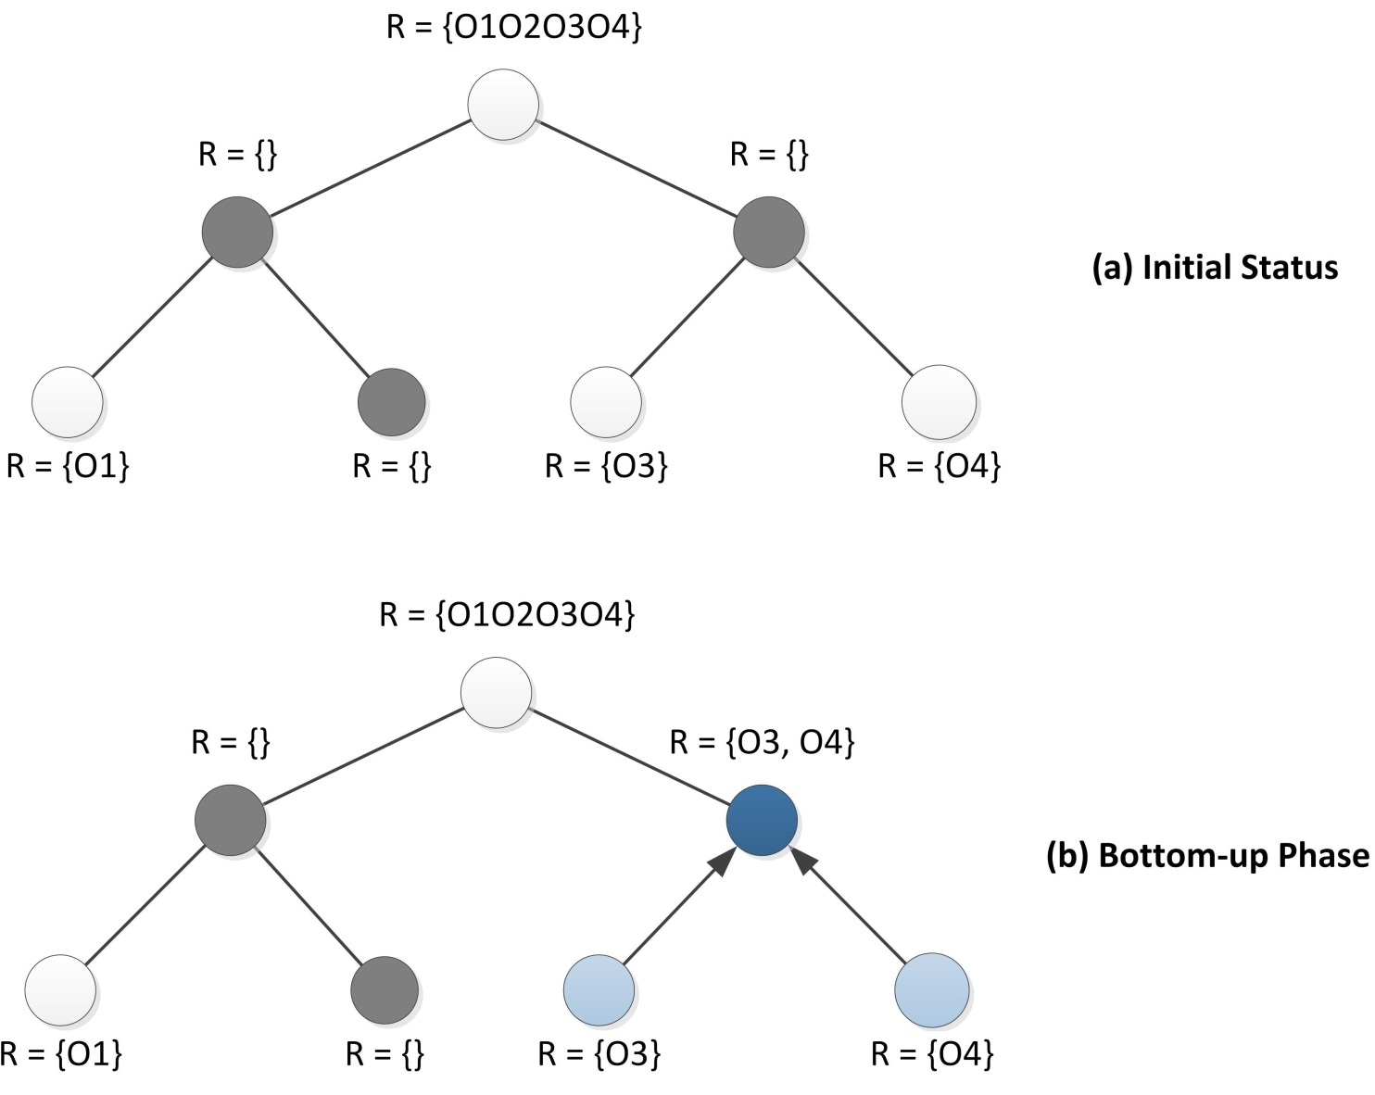
Failure Recovery
O1O2O3O4
O1O2
O3O4
O1
O2
O3
O4

Slide 20
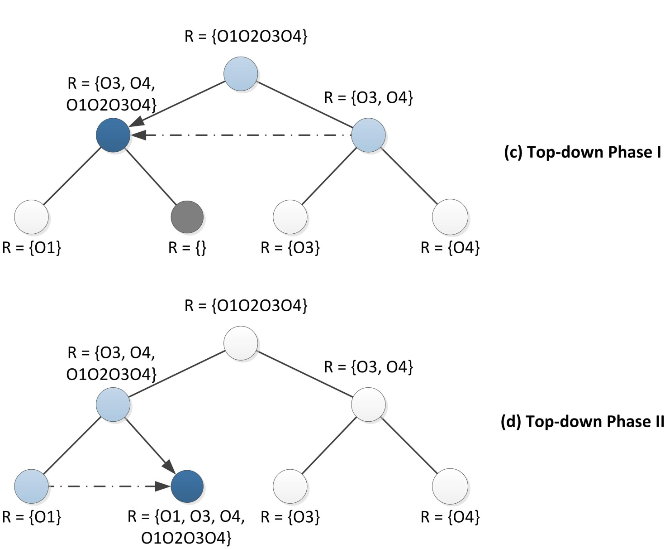
Failure Recovery (cont.)

Slide 21
Failure Recovery – Slave Side
The master assigns Slave 10 to restore missing part O3O4. O3 and O4 are desired for this recovery.
Recover: O3O4
<O3, Slave 9>
<O4, Slave 6>
Master
Slave 10
O3O4
Slave 9
Slave 6
O3
O4

Slide 22
Experiments - Settings
System: 1 master, 1 client, 10 slaves and 40 files stored
We run each experiment 20 times, so every point reported in the following diagrams are the average of 20 results

Slide 23
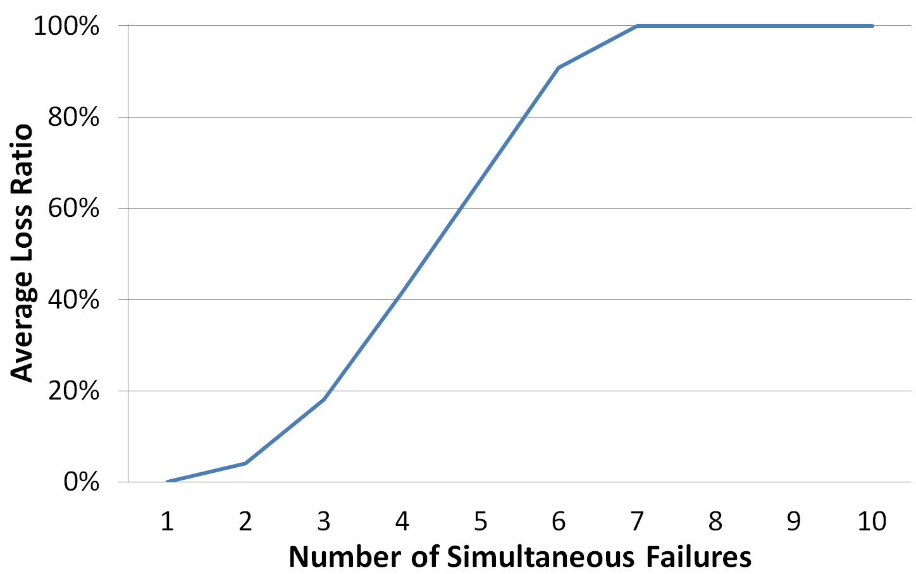
Experiments

Slide 24
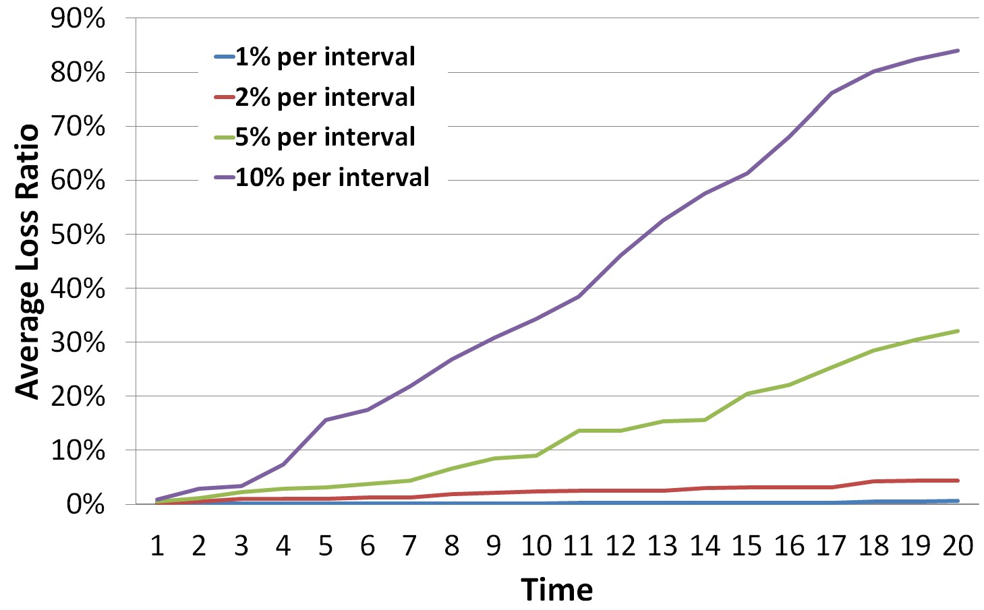
Experiments (cont.)

Slide 25

Q&A
Thanks

